Slide 1
Pricing Proposal Template

Slide 2
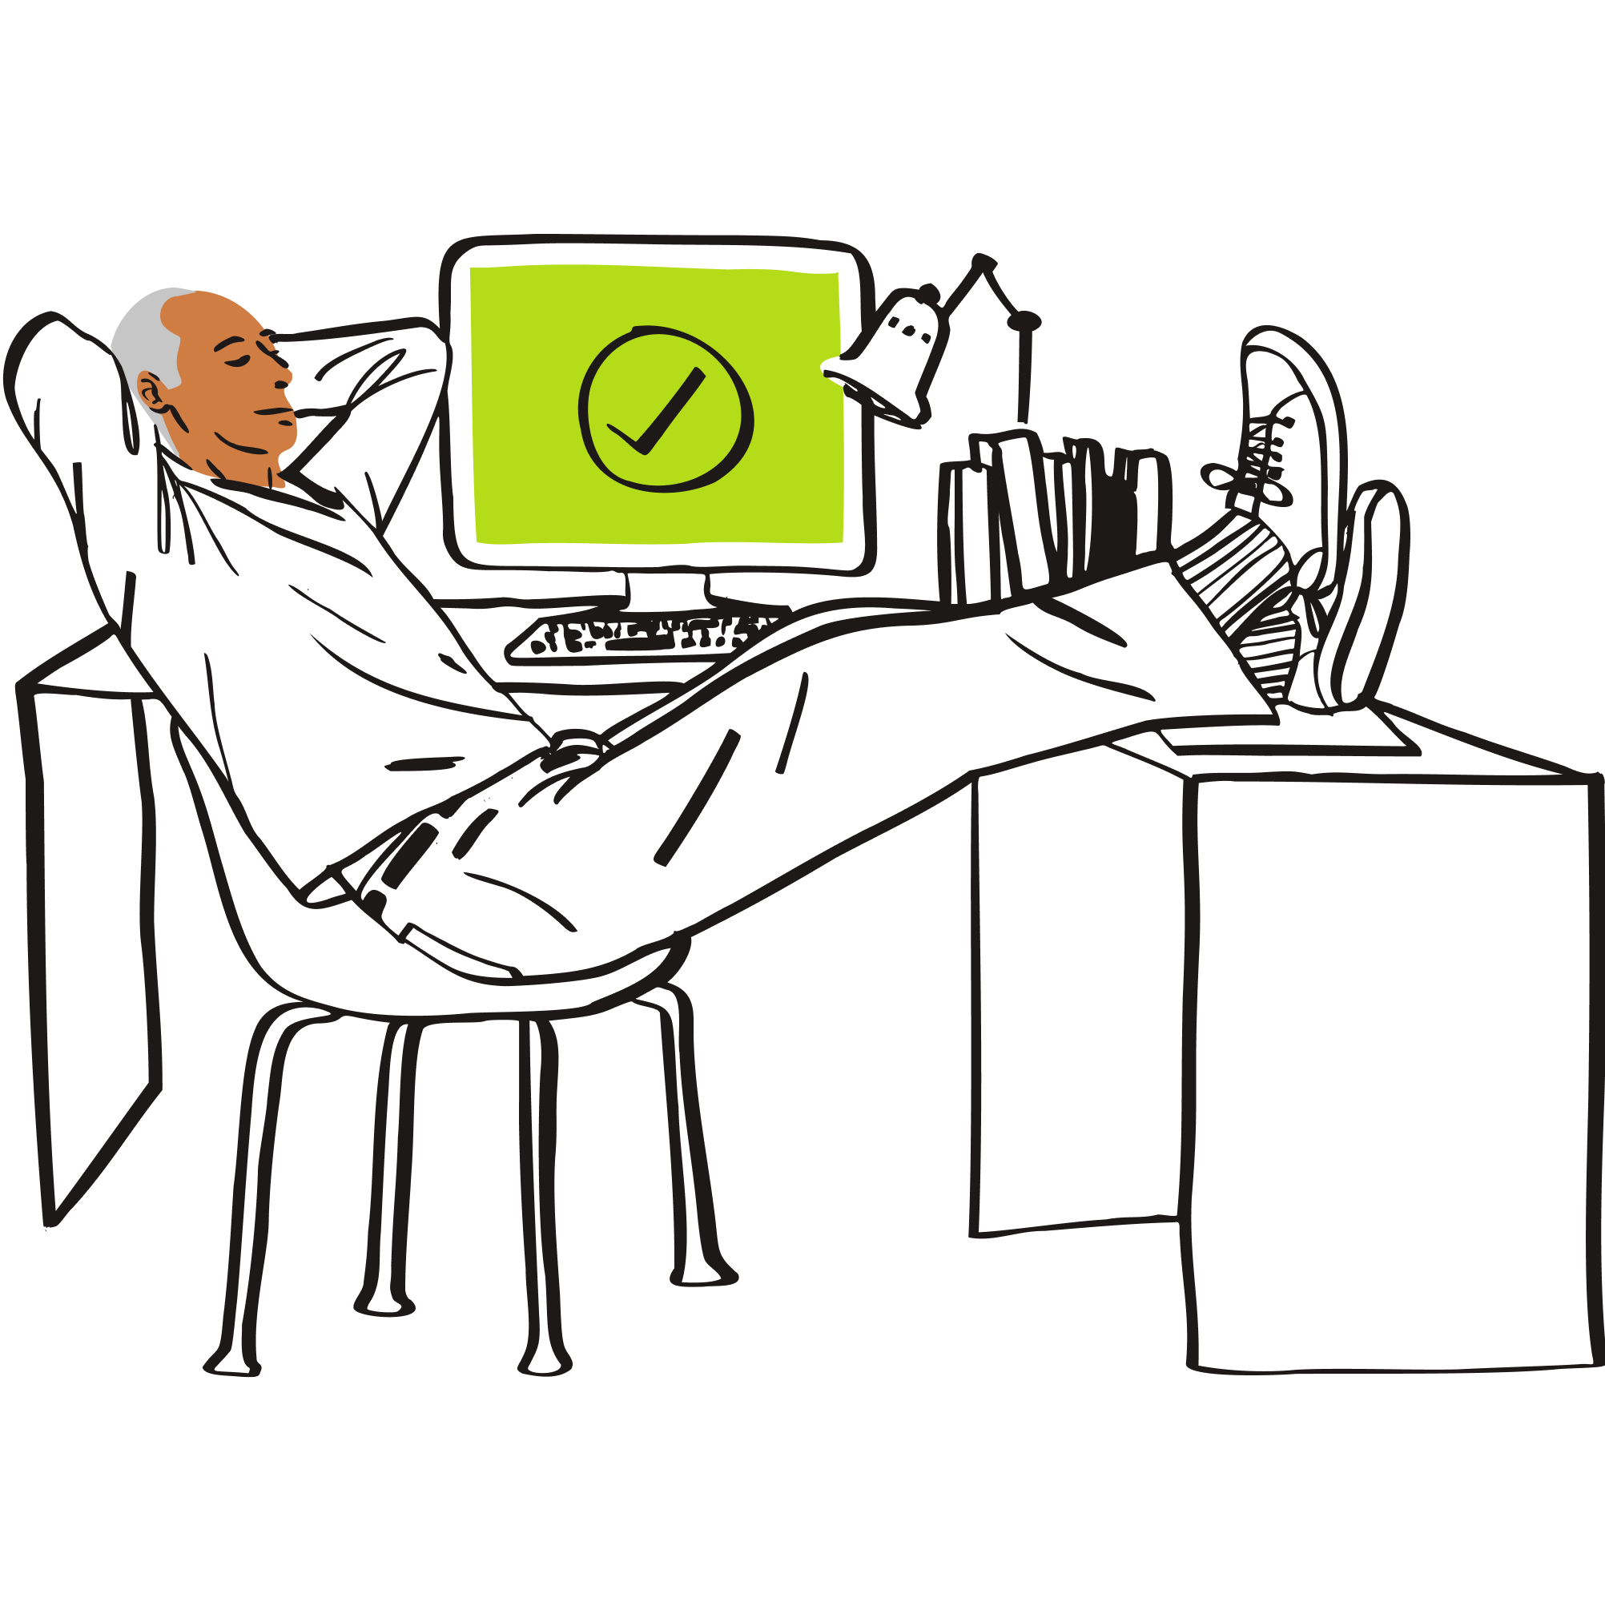



x3
Why format it this way?
Placeholder slide only. DO NOT USE.
Collect real-time document-level analytics to track top performing pages, average completion percentage, and document version performance.
Share, track, optimize
Track which links have been forwarded to someone that you haven’t engaged with yet, and enable email verification to identify them.
DocSend document analytics gives business leaders actionable insight into exactly how viewers are engaging with their shared collateral.
Uncover stakeholders
Analyze page-by-page insights for each viewer of a document to learn their unique interests, and tailor your follow-up accordingly.
Follow up intelligently

Slide 3
STOP: MAKE A COPY OF THIS DECK BEFORE YOU START
Make a copy of this deck, edit all page elements (headlines, body text, image/graph block & logo placement) as you see fit.

Slide 4
[Logo]
[Company]
Pricing Proposal - [mm/dd/yy]
Add image
[Name, Position, Email]
Your logo
Confidential | Last updated [mm/dd/yy]

Slide 5
x2
Table of Contents
1. Vision & Mission Statement
5. Our Prices
2. Our Team
6. Proposal Objective
3. Our Clients
7. Proposal Timeline
4. Our Services
8. Investment Breakdown
Your logo
Confidential | Last updated [mm/dd/yy]

Slide 6
Vision & Mission
Share with potential customers what your work is all about. Highlight your vision, mission, and passion for what you do.
Your logo
Confidential | Last updated [mm/dd/yy]

Slide 7



Our Team
First Name
Last Name
Bio text goes here
First Name
Last Name
Bio text goes here
First Name
Last Name
Bio text goes here
Introduce your team. Include names, titles, and how each person will interact with your potential client.
Your logo
Confidential | Last updated [mm/dd/yy]

Slide 8

Our Clients
Add client logo
Add client logo
Add client logo
[Company Name]
[Company Name]
[Company Name]
Briefly describe the work you’ve done for previous clients.
Highlight their results, success stories, and what you learned.
Make sure to include any noteworthy campaigns and/or business outcomes.
Your logo
Confidential | Last updated [mm/dd/yy]

Slide 9
x3
“Share a recent client testimonial with your prospect(s).”
- Client name, role, company
Your logo
Confidential | Last updated [mm/dd/yy]

Slide 10
Our Services
Website & SEO audit
PR & Comms strategy
Brand & Product development
Paid Media management
Product Innovation
Provide an overview of your company’s services.
Your logo
Confidential | Last updated [mm/dd/yy]

Slide 11
Our Prices
Standard |  | Professional |  | Enterprise
Content creation Social media management Paid campaign management $XX per month / $XX per year |  | Everything in Standard plus: A/B testing Communications strategy $XX per month / $XX per year |  | Everything in Professional plus: Event sponsorships Brand partnership management $XX per month / $XX per year
Your logo
Confidential | Last updated [mm/dd/yy]

Slide 12
Proposal Objective
Test new and emerging markets
Increase brand share of voice
Secure XX strategic partnerships
Launch and optimize paid media campaigns
Generate social buzz around upcoming product launches
State how your proposal aligns with your prospect’s business goals, and include any expected outcomes.
Your logo
Confidential | Last updated [mm/dd/yy]

Slide 13
Q1
Q2
Q3
Q4
Project Timeline
Campaigns | N/A | Launch paid media campaign | Secure XX media mentions | Launch XX key brand partnerships
Launch Activities | Website audit Conduct market research | Optimize ad placements & spend Conduct A/B testing | Secure XX speaking gigs Organic social promo | Secure XX event sponsorships Increase share of voice
Ongoing Initiatives | Monitor site health & performance | Analyze A/B test results | Develop product launch plans | Identify new media outlets
Your logo
Confidential | Last updated [mm/dd/yy]

Slide 14
Investment Breakdown
 | Itemized Cost
Monthly services | $500.00
Discounts | 10%
Taxes | 5%
Grand Total | $485.00
Provide an in-depth breakdown of your proposed pricing. Include itemized costs, discounts, taxes, and the grand total.
Sharing this level of detail with prospects helps simplify the quote’s structure and avoids potential confusion down the road.
Your logo
Confidential | Last updated [mm/dd/yy]

Slide 15
[Company]
Pricing Proposal - [mm/dd/yy]
[website]
Add graph or image
[Address | Phone | Email]
Your logo
Confidential | Last updated [mm/dd/yy]

